Slide 1
Turbine Casing – CFD & FEM Combined Analysis
Ing. Jacopo Fumanti Petrini
Software used: Siemens NX Simcenter | Ansys 2025 R1
The turbine casing should be considered as a scale model

Slide 2
Objective
Evaluate the aerodynamic and structural performance of a turbine casing.
Perform a CFD simulation to analyze the internal air velocity field.
Carry out a FEM (static structural) analysis to assess stress distribution under loading conditions.
Identify possible design optimizations for improved efficiency and reliability.

Slide 3
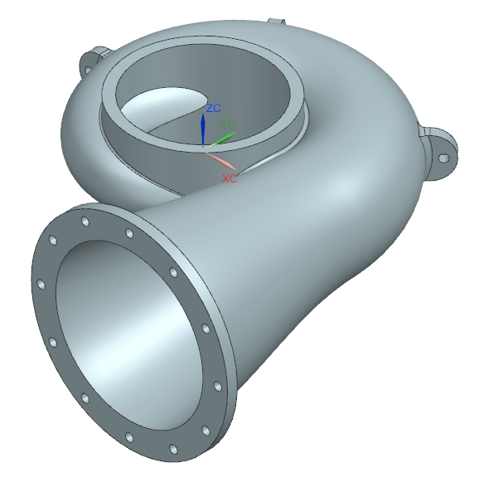
Geometry and Model Description
The component analyzed represents the volute casing of a small turbine stage.
CAD geometry modeled in Siemens NX and imported into Ansys 2025 R1 for structural validation.
Casing material: Steel
The casing features:
Tangential inlet
Gradual cross-section reduction
Outlet flange for turbine connection

Slide 4
CFD Setup
Fluid: Air (ideal gas)
Flow type: Steady-state, incompressible
Boundary conditions:
Inlet: Velocity 30 m/s (approx.)
Outlet: Static pressure = 0 Pa
Turbulence model: Standard k–ε
Mesh: Hybrid tetrahedral with boundary layer refinement

Slide 5
CFD Results – Velocity Field
Velocity range: 1.5 – 30 m/s.
Flow acceleration observed along the curved volute.
High-velocity region near outlet → good flow guidance.
Low-velocity recirculation zones visible near the inlet curvature.
CFD confirms the casing ensures smooth air delivery toward the turbine inlet.

Slide 6
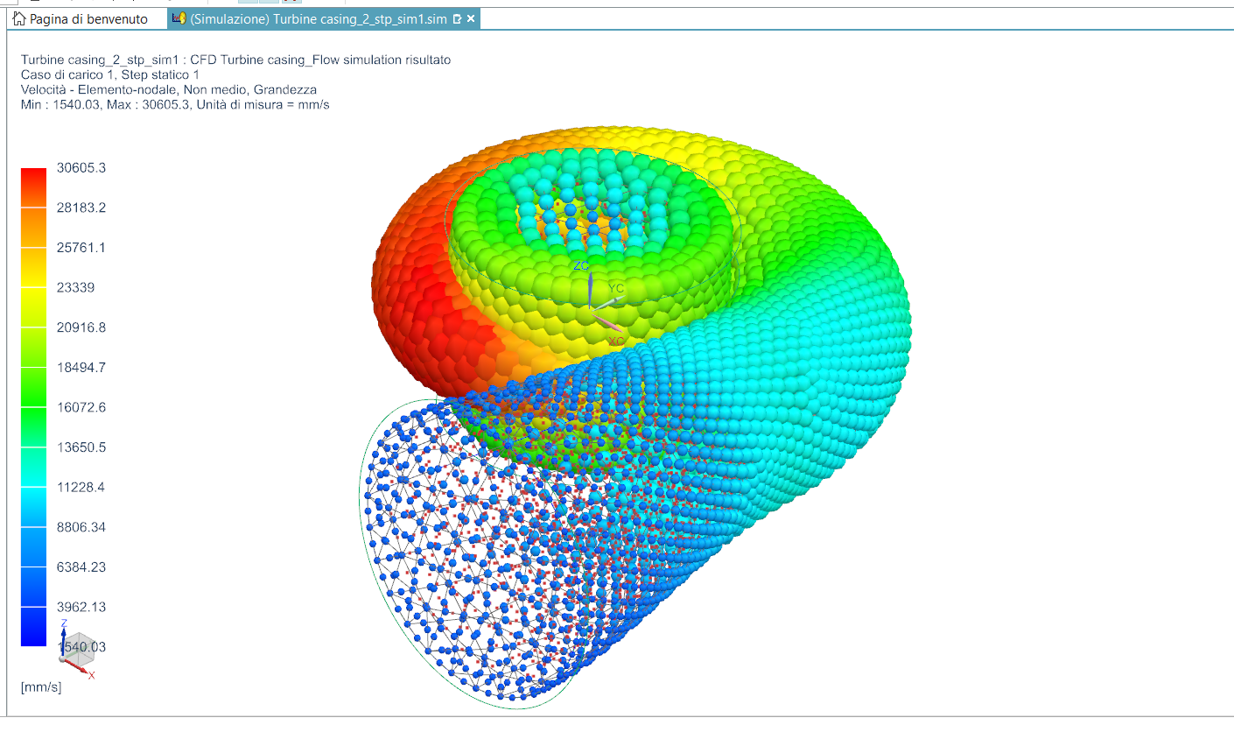
CFD Results – Velocity Field
CFD analysis shows the air velocity distribution within the turbine casing.
The flow enters tangentially, accelerating along the spiral path, with a peak velocity of 30.6 m/s.

Slide 7
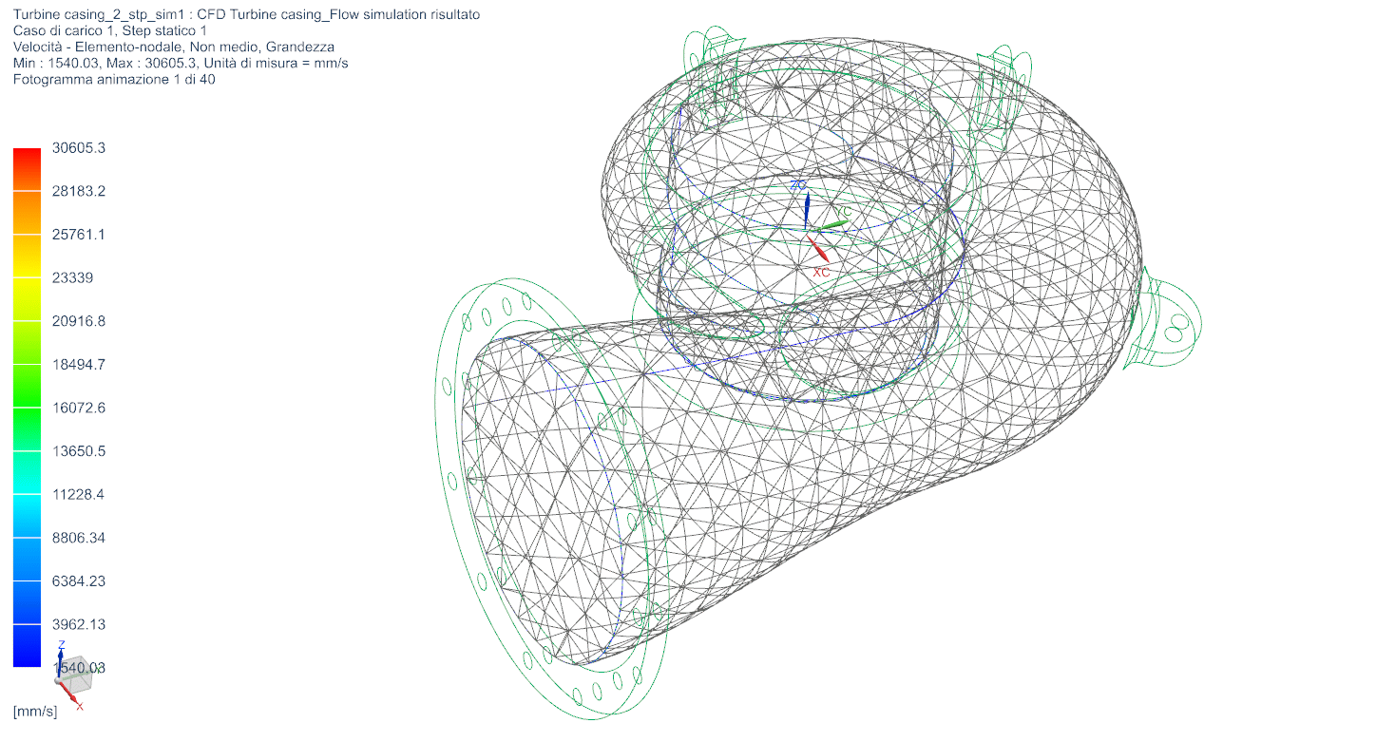
CFD Results – Velocity Field
CFD analysis shows the air velocity distribution within the turbine casing.
The flow enters tangentially, accelerating along the spiral path, with a peak velocity of 30.6 m/s.

Slide 8
FEM Setup
Material: Steel (E = 207 GPa, ν = 0.33)
Boundary conditions:
Fixed support at mounting flange.
Two 1000 N forces applied at casing outer surface to simulate pressure load.
Mesh: Tetrahedral solid elements with local refinement in high-stress regions.

Slide 9
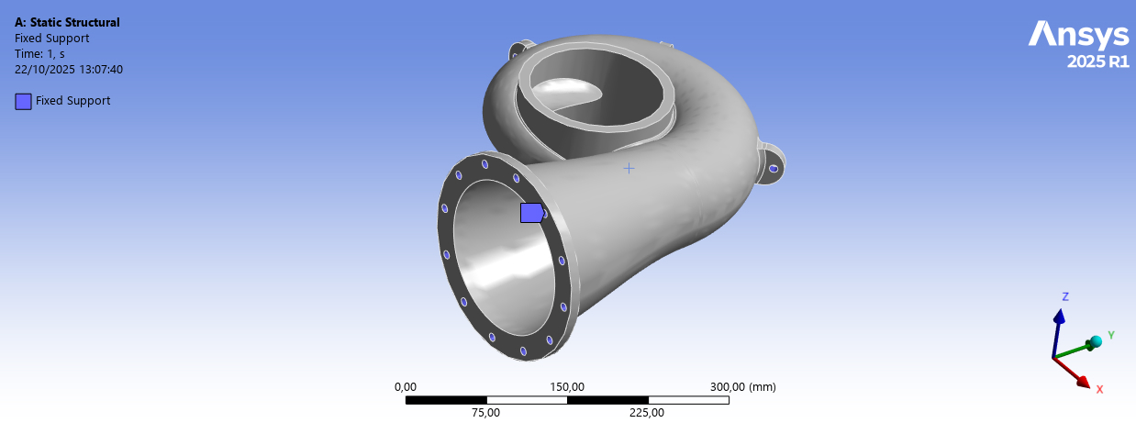
FEM Setup
Fixed support at mounting flange

Slide 10
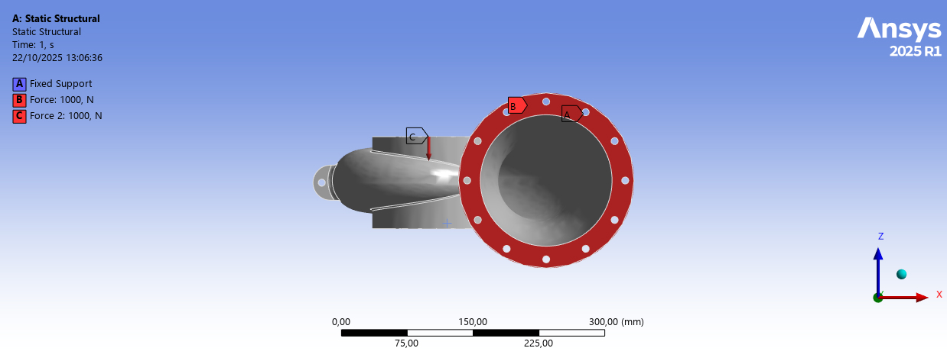
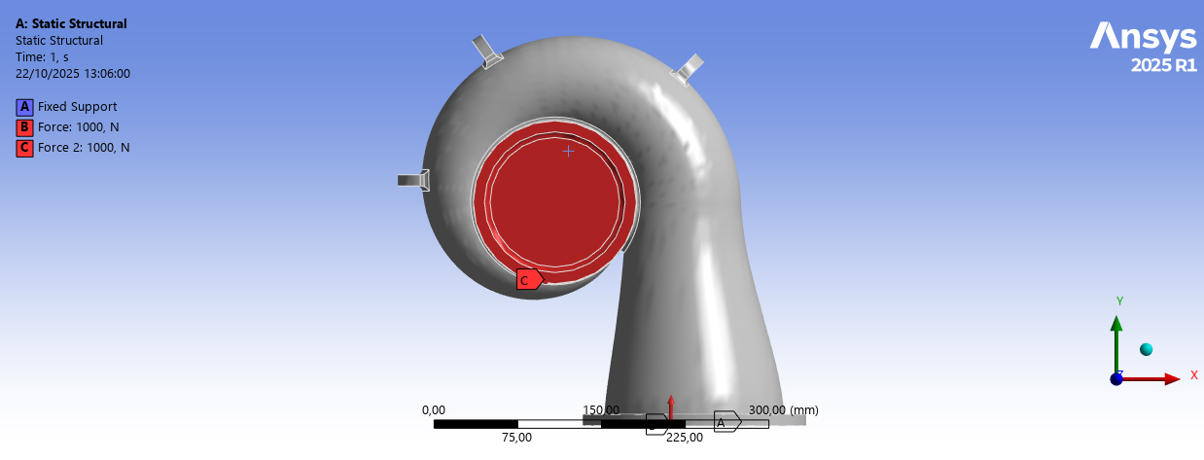
FEM Setup
1000 N forces applied at casing outer surface – Front view
1000 N forces applied at casing outer surface – Top view

Slide 11
FEM Results – Equivalent Stress (von Mises)
Maximum equivalent stress: 6.91 MPa
Stress concentration observed near the fixed flange and load application points.
Structural integrity verified with high safety margin.
Deformation negligible under the applied load (quasi-rigid behavior).

Slide 12
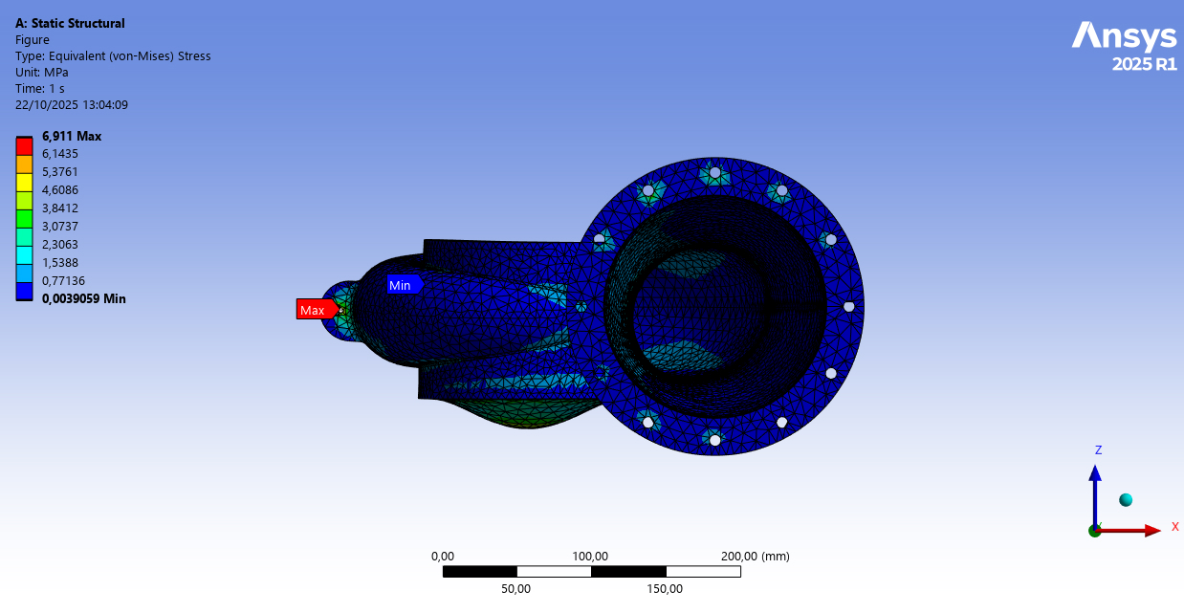
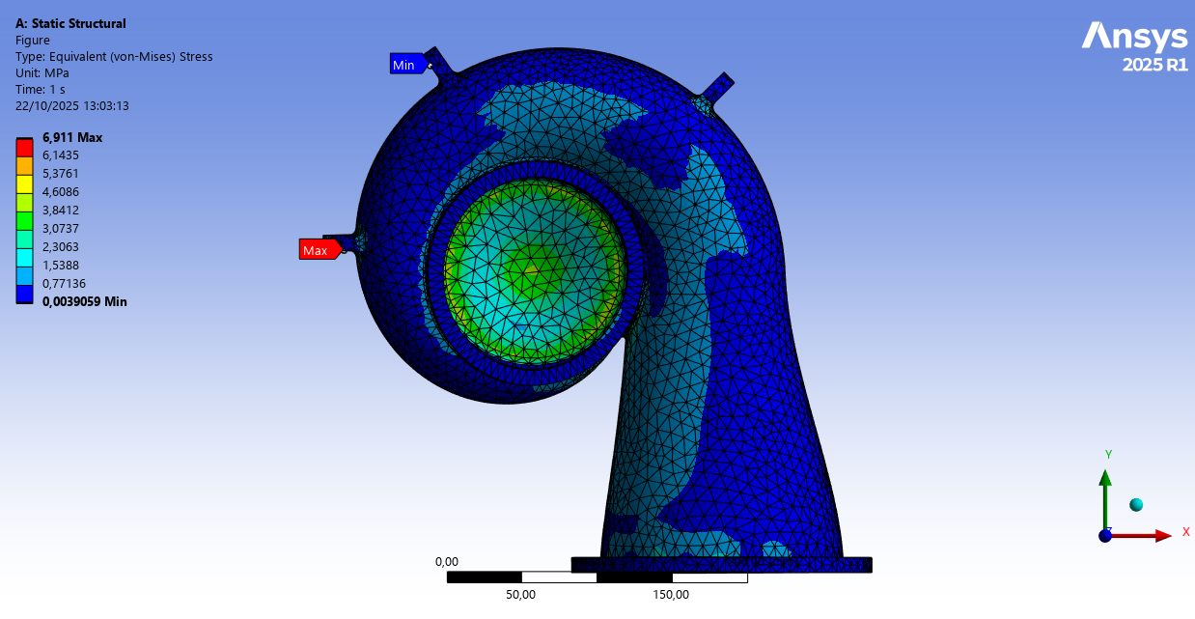
FEM Results – Equivalent Stress (von Mises)
The FEM analysis simulated a 1000 N load applied at both inlet and outlet flanges.
Maximum stress: 6.9 MPa (at the flange connection).
The structure remains well below typical material yield limits, confirming design robustness.

Slide 13
Discussion
CFD and FEM analyses confirm the robustness and flow efficiency of the casing design.
Airflow is well-distributed, with minimal recirculation effects.
Structural stresses remain well within allowable limits.
Combined simulation approach demonstrates design feasibility and readiness for prototyping.

Slide 14
Conclusions
The turbine casing geometry shows good aerodynamic and structural behavior.
CFD analysis confirms proper flow acceleration and guidance.
FEM results demonstrate low stress levels and excellent mechanical reliability.
Further improvements could focus on optimizing the curvature for smoother flow transitions.
The turbine casing should be considered as a scale model

